Slide 1
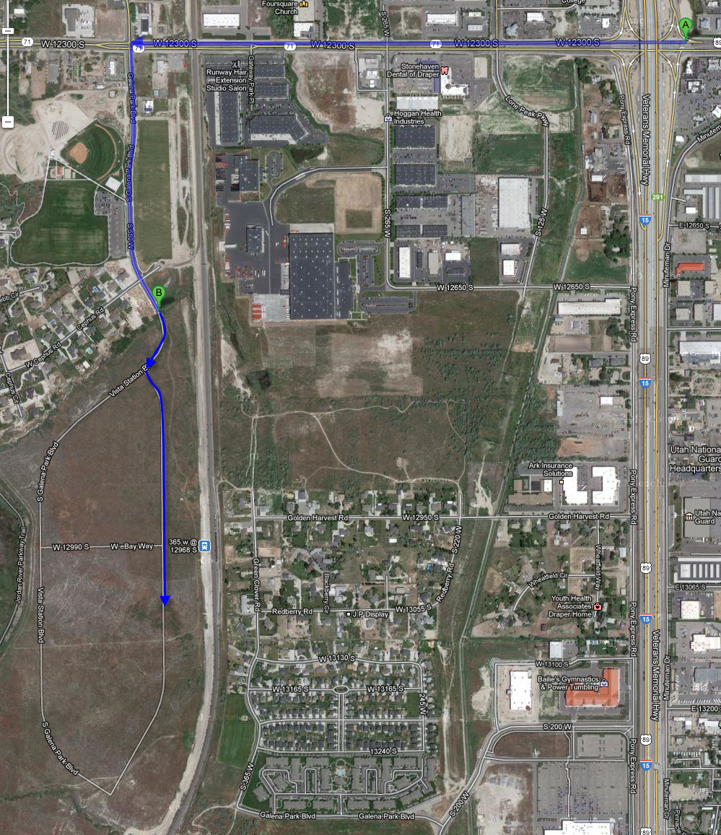
12300 South
Galena
Park
Blvd
SLC B6 & B7
583 W eBay Way
Draper, UT 84020
Directions from I-15:
Exit 12300 South
Go West on 12300 South
South (L) on Galena Park Blvd
South (L) on Frontrunner Blvd
West (L) into parking lot (will be past eBay Way and past the building)
Employee parking is located on the South side of the buildings.
Frontrunner
Blvd
eBay
N

Slide 2
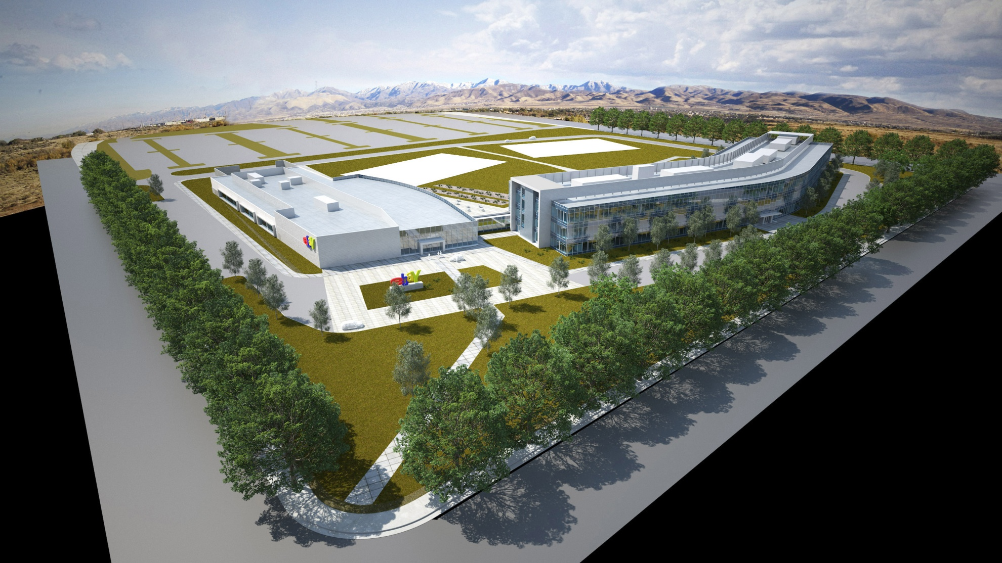
Parking
Handicapped and Maternity Parking
Main Entrance
Frontrunner Blvd.
W. eBay Way
To Frontrunner Station

